Slide 1
The Laplace Transform
Central Institute of Tool Design
Shravankumar’s

Slide 2
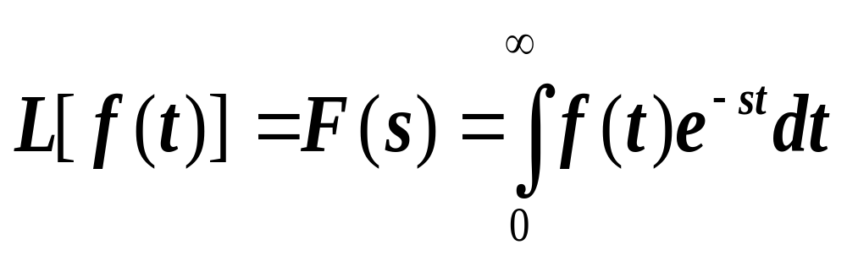
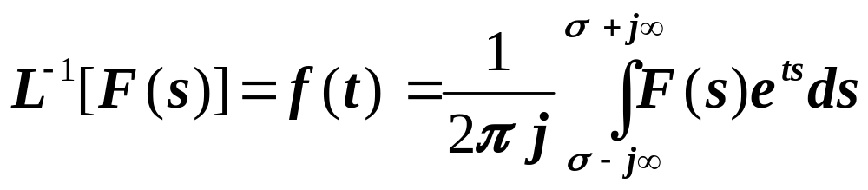
The Laplace Transform
The Laplace Transform of a function, f(t), is defined as;
Eq A
The Inverse Laplace Transform is defined by
Eq B
*notes
Notes:
In the undergraduate curriculum, usually there are 3 transform pairs that are studied.
These are
The Laplace Transform
The Fourier Transform
The Z-Transform
The Laplace transform is usually used in solving continuous linear differential equations of the type encountered in circuit theory and systems. The advantage of the Laplace transform is that it makes cumbersome differential equations algebraic and therefore the math becomes simpler to handle. In the end we can take the inverse and go back to the time domain. In systems, for example, we stay with the Laplace variable “s” while investigating system stability, system performance. We use tools such as the root locus and block diagrams which are directly in the s variable. Even Bode is used where s is replaced by jw. We are “walking” with one foot in s but thinking the time domain.
The Fourier transform is used very much in communication theory, field theory and generally in the study of signal spectrum and both analog and digital filter analysis and design.
The Z-transform is sort of similar to the Laplace transform. In fact, many of the manipulations such as partial fraction expansion, taking the inverse, interrupting stability are very similar to those performed in the Laplace. The big difference is that the Z-transform is used for discrete systems and difference equations. At the University of Tennessee you will be studying the Fourier and Z-transforms in your junior year and you will also study the Laplace transform again.

Slide 3
The Laplace Transform
We generally do not use Eq B to take the inverse Laplace. However,
this is the formal way that one would take the inverse. To use
Eq B requires a background in the use of complex variables and
the theory of residues. Fortunately, we can accomplish the same
goal (that of taking the inverse Laplace) by using partial fraction
expansion and recognizing transform pairs.
*notes
Notes:
Normally, even in the junior year, you will still use partial fraction expansion and recognition of transform paisr to find the inverse Laplace transform. This is true in most undergraduate programs. However, at UTK we have a graduate course that is required of all graduate students in electrical engineering in which an in-depth study is made of using Eq B for taking the inverse Laplace. A similar integral is encountered for taking the inverse in both Fourier and Z-transforms.
It might also be noted that not all functions have a Laplace transform. For a function to be Laplace transformable it must be of exponential order. This boils down to saying that the integral from 0 to infinity of e^{-at}|f(t)|dt must be less than infinity. In this course, and most courses in undergraduate studies, the functions we are
interested in taking the Laplace will be of exponential order.

Slide 4
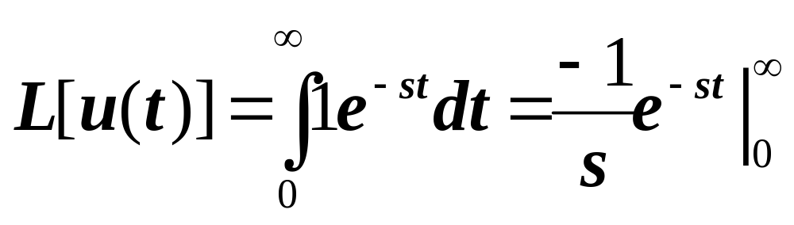
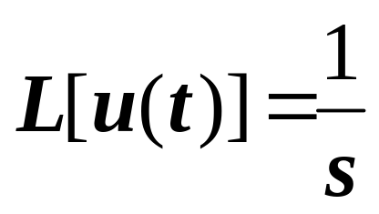

The Laplace Transform
Laplace Transform of the unit step.
The Laplace Transform of a unit step is:
*notes
Notes:
The unit step is called a singularity function because it does not possess a derivative at t = 0. We also say that it is not defined at t = 0. Along this line, you will note that many text books define the Laplace by using a lower limit of 0⁻ rather than absolute zero. One must ask, if you integrate from 0 to infinity for a unit step, how are you handling the lower limit when the step is not defined at t = 0? We will not get worked up over this. You can take this apart later after you become experts in transforms.

Slide 5
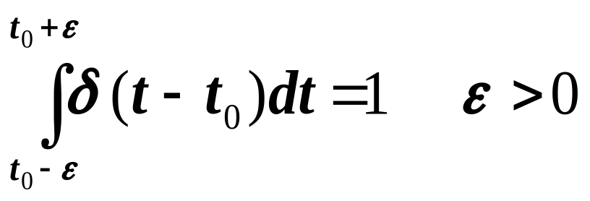

The Laplace Transform
The Laplace transform of a unit impulse:
Pictorially, the unit impulse appears as follows:
f(t)
δ(t – t₀)
0
t₀
Mathematically:
δ(t – t₀) = 0 t
0
*note
Notes:
I remember when I was first introduced to the unit impulse function, in an electrical engineering course at Auburn University. Essentially, we were told that the unit impulse function was a function that was infinitely high and had zero width but the area under the function was 1. Such an explanation would probably always disturb a mathematician because I expect the proper way to define the function is in a limiting process as a function that is 1/delta in height and delta wide and we take the limit as delta goes to zero.
At this point, the best thing to do is not to worry about it. Accept it as we have defined it here and go ahead and use it. Probably one day in a higher level math course you may give more attention to its attributes.

Slide 6
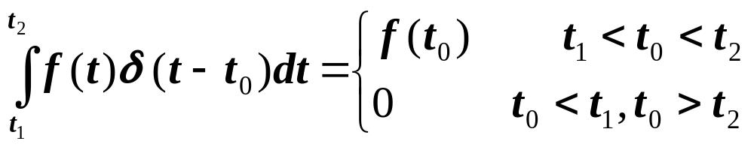
The Laplace Transform
The Laplace transform of a unit impulse:
An important property of the unit impulse is a sifting
or sampling property. The following is an important.

Slide 7
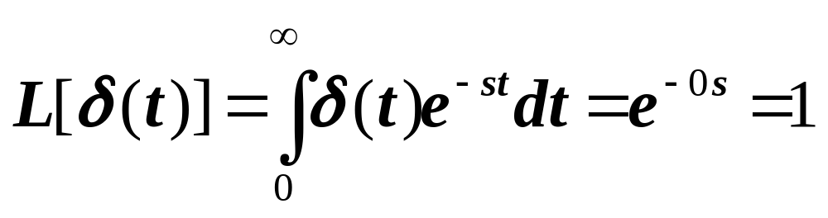
The Laplace Transform
The Laplace transform of a unit impulse:
In particular, if we let f(t) = δ(t) and take the Laplace

Slide 8

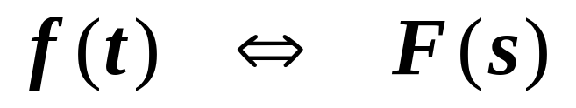
The Laplace Transform
An important point to remember:
The above is a statement that f(t) and F(s) are
transform pairs. What this means is that for
each f(t) there is a unique F(s) and for each F(s)
there is a unique f(t). If we can remember the
Pair relationships between approximately 10 of the
Laplace transform pairs we can go a long way.

Slide 9
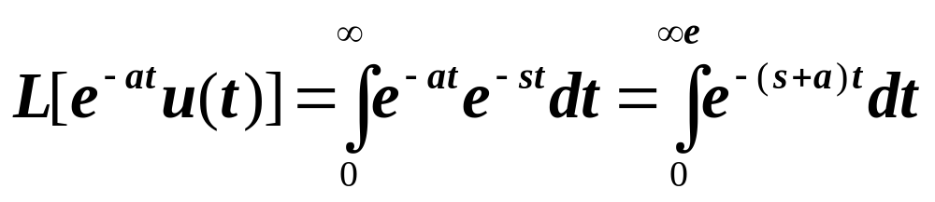

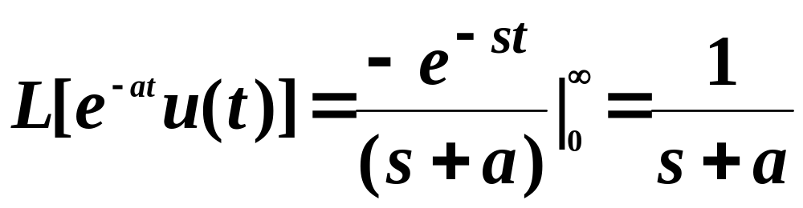
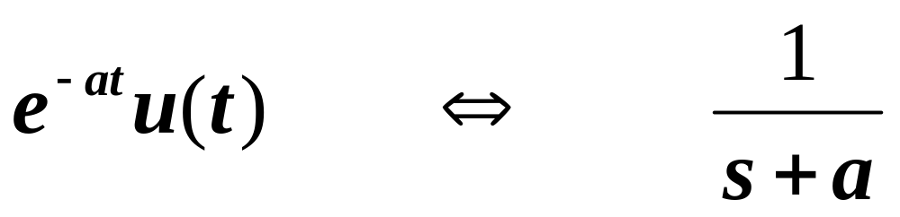
The Laplace Transform
Building transform pairs:
A transform
pair

Slide 10
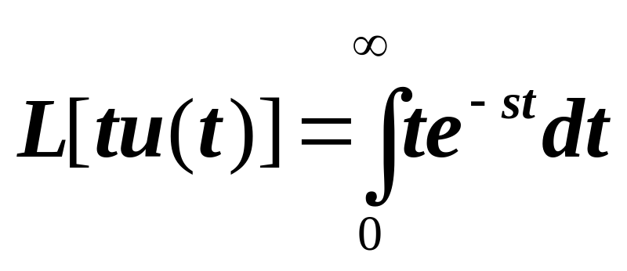
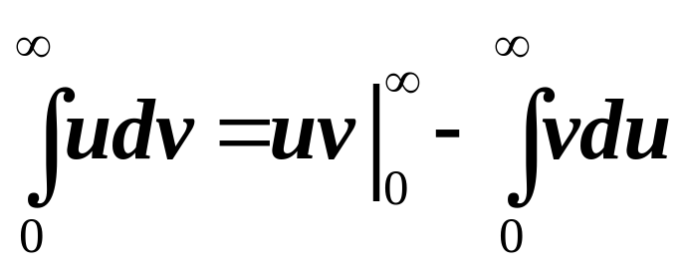
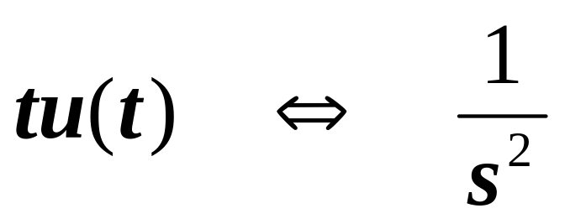
The Laplace Transform
Building transform pairs:
u = t
dv = e^{-st}dt
A transform
pair

Slide 11
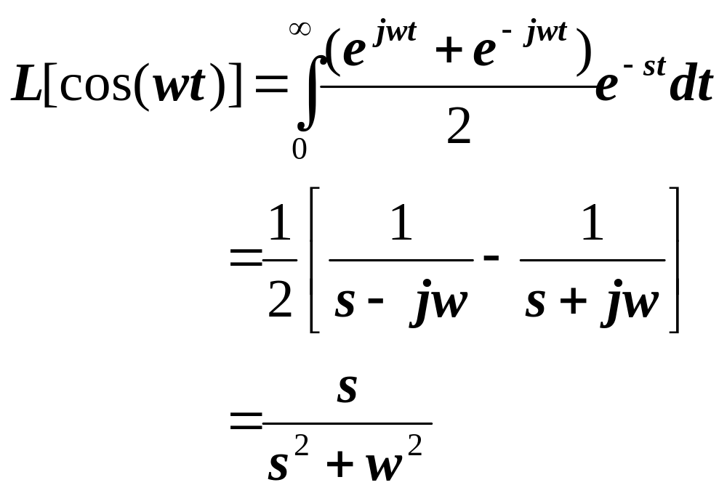
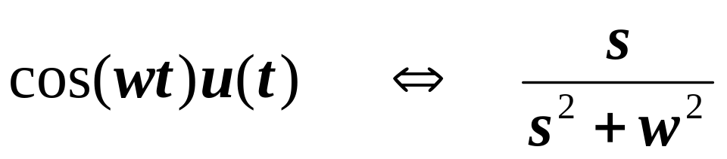
The Laplace Transform
Building transform pairs:
A transform
pair

Slide 12
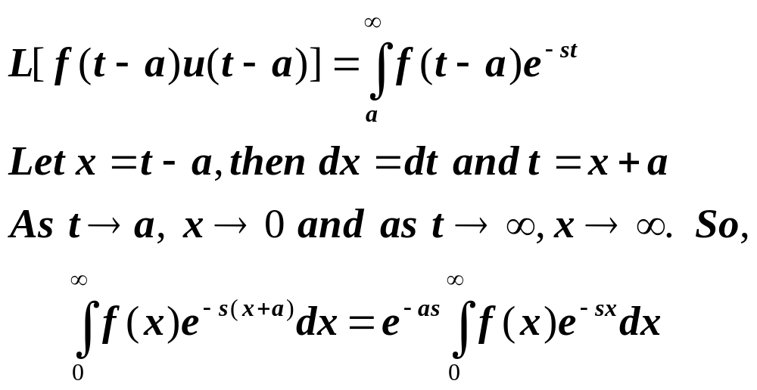
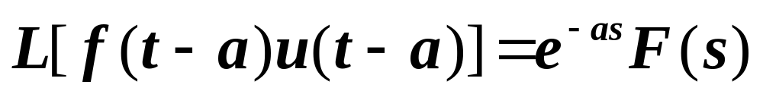
The Laplace Transform
Time Shift

Slide 13
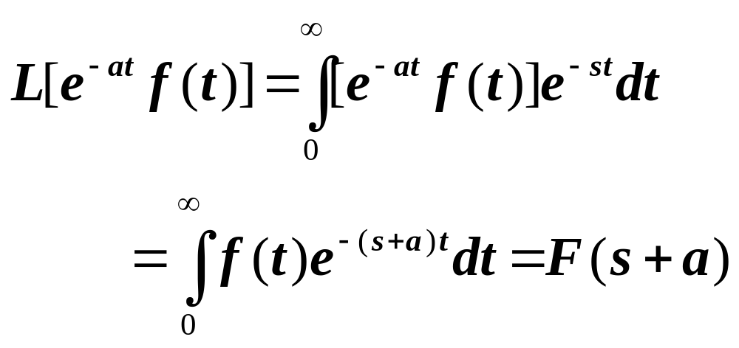
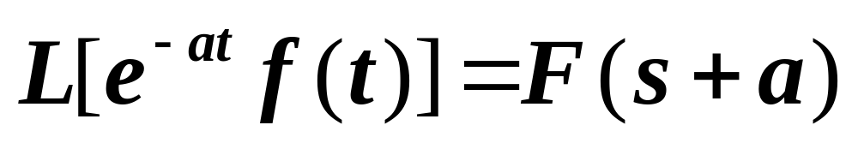
The Laplace Transform
Frequency Shift

Slide 14
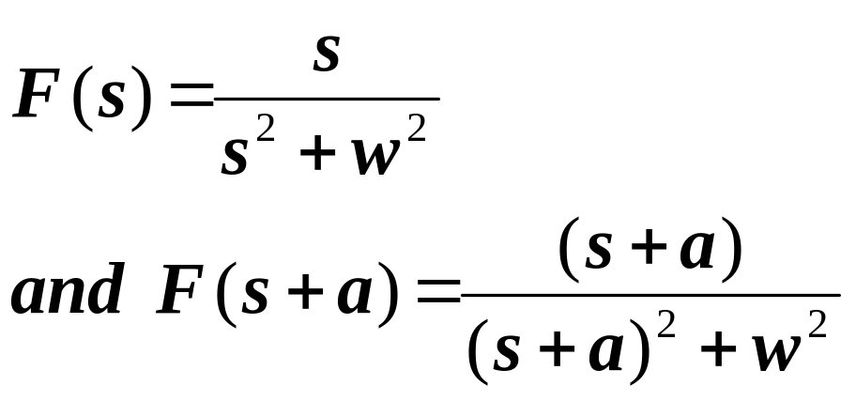
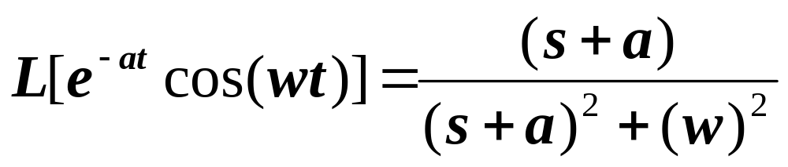
The Laplace Transform
Example: Using Frequency Shift
Find the L[e^{-at}cos(wt)]
In this case, f(t) = cos(wt) so,

Slide 15
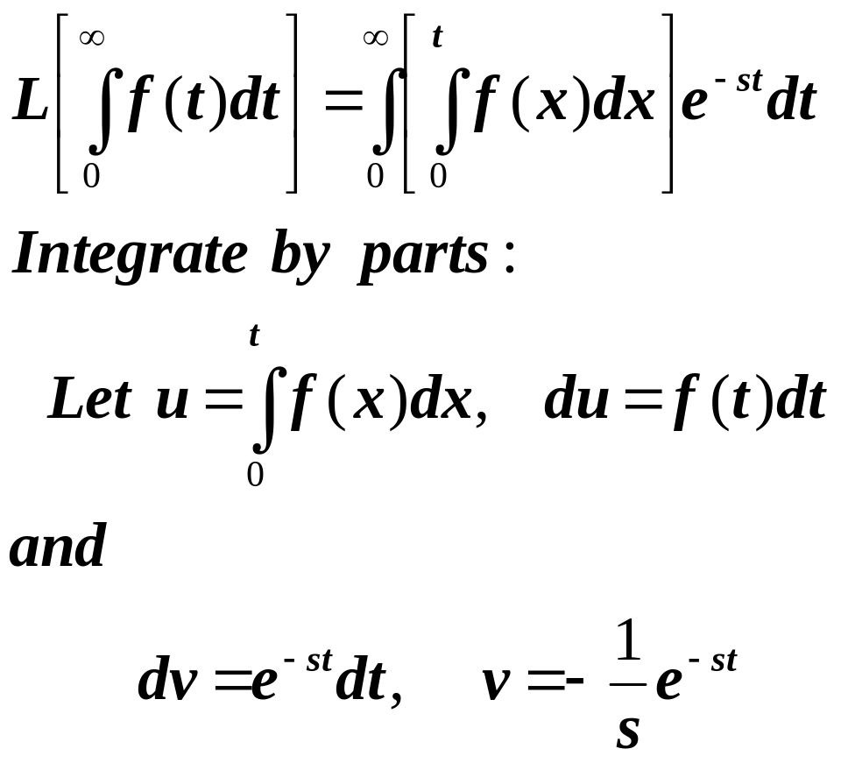
The Laplace Transform
Time Integration:
The property is:

Slide 16
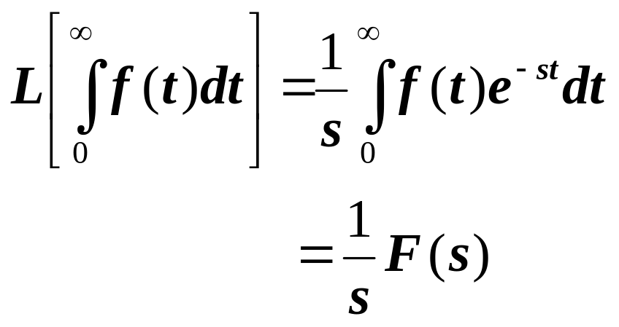
The Laplace Transform
Time Integration:
Making these substitutions and carrying out
The integration shows that

Slide 17
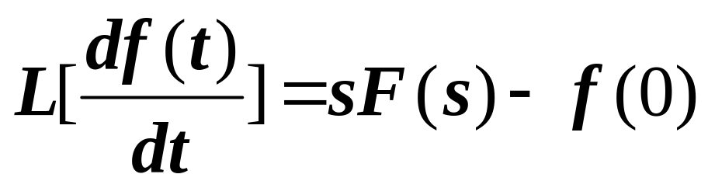
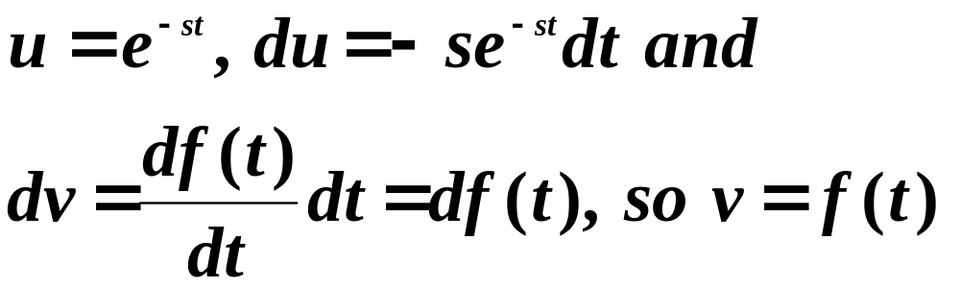
The Laplace Transform
Time Differentiation:
If the L[f(t)] = F(s), we want to show:
Integrate by parts:
*note
Notes:
As noted earlier, some text will use 0⁻ on the lower part of the defining integral
of the Laplace transform. When this is done, f(0) above will become f(0⁻).

Slide 18
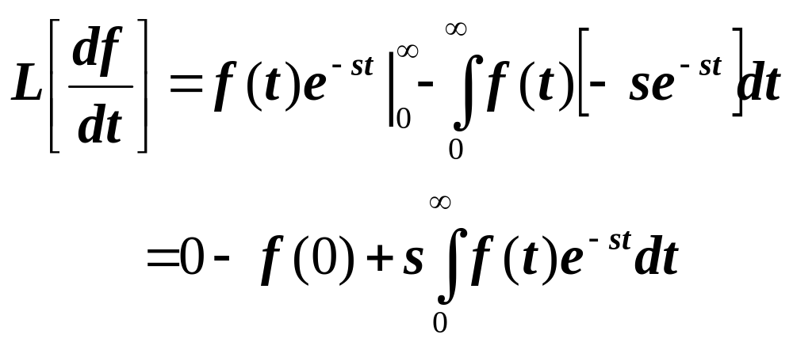
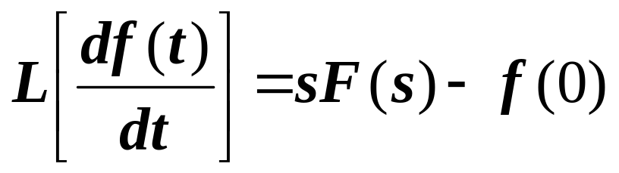
The Laplace Transform
Time Differentiation:
Making the previous substitutions gives,
So we have shown:

Slide 19
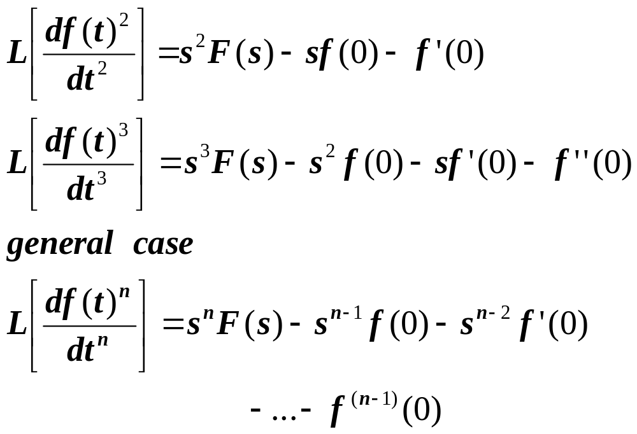
The Laplace Transform
Time Differentiation:
We can extend the previous to show;

Slide 20
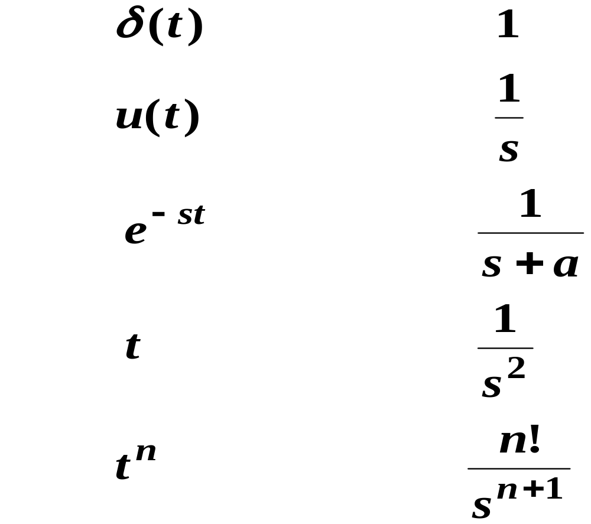
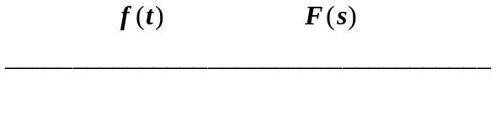
The Laplace Transform
Transform Pairs:
f(t) F(s)

Slide 21
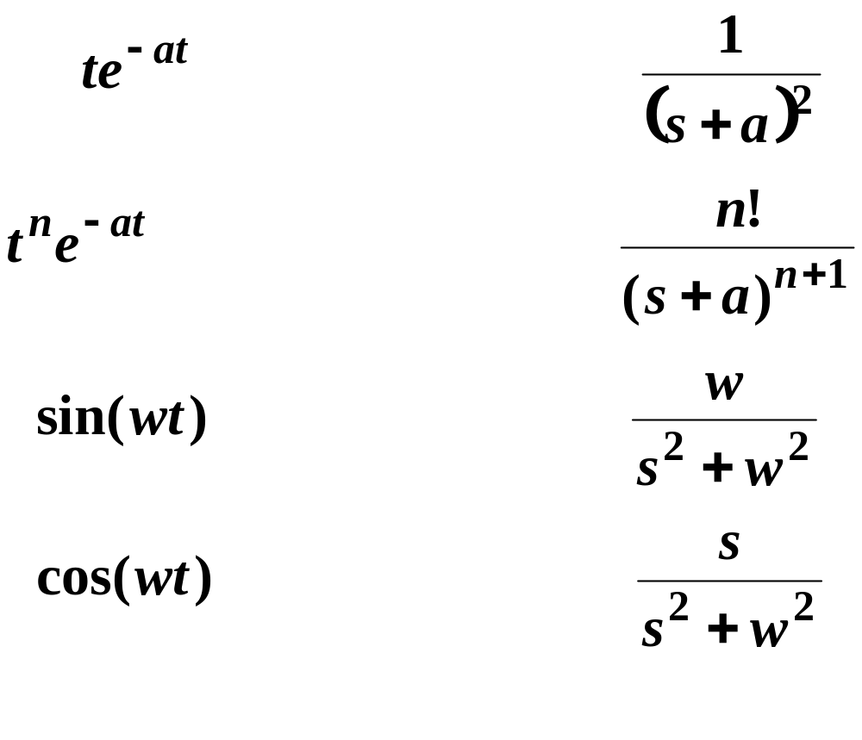
The Laplace Transform
Transform Pairs:
f(t) F(s)

Slide 22
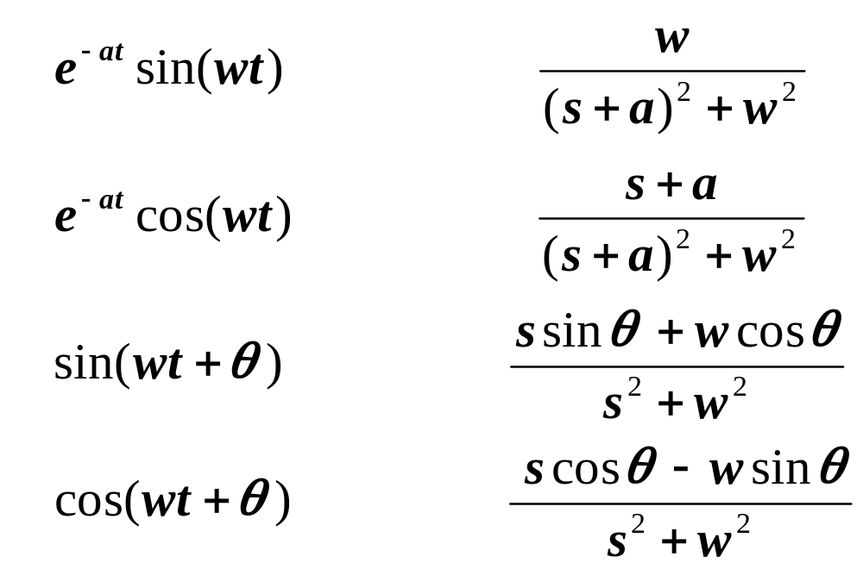

The Laplace Transform
Transform Pairs:
f(t) F(s)
Yes !

Slide 23
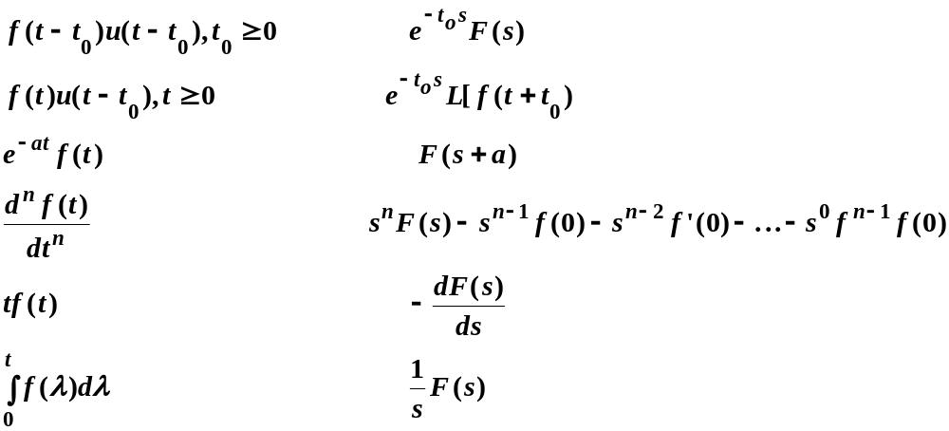
The Laplace Transform
Common Transform Properties:
f(t)
F(s)

Slide 24
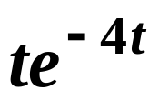
The Laplace Transform
Using Matlab with Laplace transform:
Example
Use Matlab to find the transform of
The following is written in italic to indicate Matlab code
syms t,s
laplace(t*exp(-4*t),t,s)
ans =
1/(s+4)^2

Slide 25
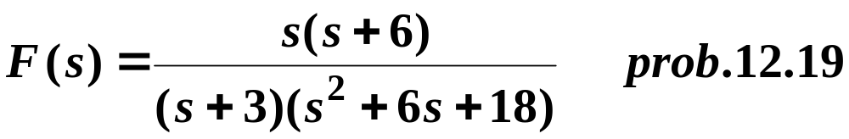
The Laplace Transform
Using Matlab with Laplace transform:
Example
Use Matlab to find the inverse transform of
syms s t
ilaplace(s*(s+6)/((s+3)*(s^2+6*s+18)))
ans =
-exp(-3*t)+2*exp(-3*t)*cos(3*t)

Slide 26
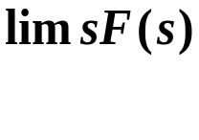

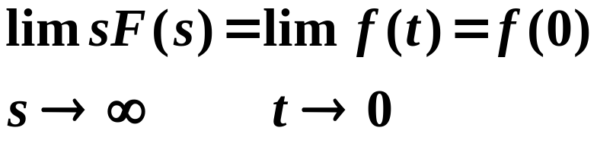
The Laplace Transform
Theorem:
Initial Value
Theorem:
If the function f(t) and its first derivative are Laplace transformable and f(t)
Has the Laplace transform F(s), and the exists, then
Initial Value
Theorem
The utility of this theorem lies in not having to take the inverse of F(s)
in order to find out the initial condition in the time domain. This is
particularly useful in circuits and systems.

Slide 27
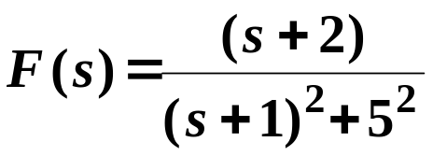
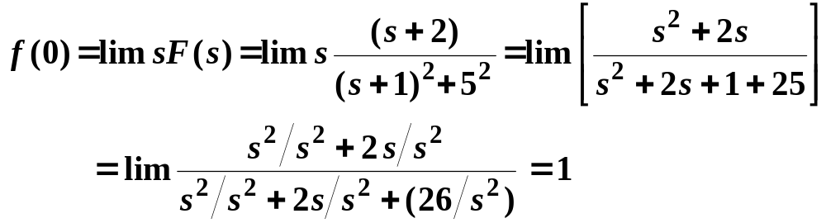
The Laplace Transform
Example:
Initial Value
Theorem:
Given;
Find f(0)

Slide 28

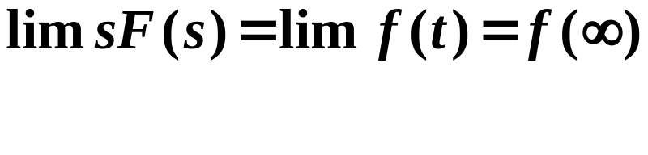


The Laplace Transform
Theorem:
Final Value
Theorem:
If the function f(t) and its first derivative are Laplace transformable and f(t)
has the Laplace transform F(s), and the exists, then
Final Value
Theorem
Again, the utility of this theorem lies in not having to take the inverse
of F(s) in order to find out the final value of f(t) in the time domain.
This is particularly useful in circuits and systems.

Slide 29
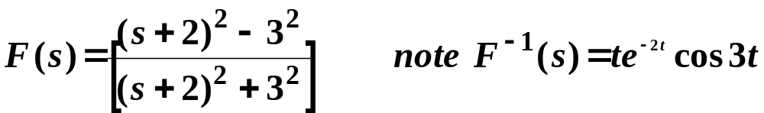

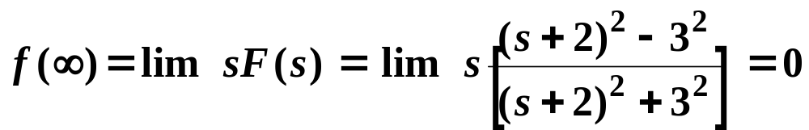

The Laplace Transform
Example:
Final Value
Theorem:
Given:
Find
.

Slide 30



